Slide 1
Middleware and handoff to human

Slide 2
Intercepting messages
Middleware
Capture incoming and outgoing messages
Usage
Logging
Troubleshooting

Slide 3
Privacy concerns
Bot Framework does not store messages
State (UserData, ConversationData, DialogData) is stored
Provide details to your users about what is stored
If you will be logging messages for learning purposes, ensure you let your users know
Chat with your legal department

Slide 4
Even more privacy concerns
Bot Framework does not store messages
Other channels may
Facebook
Other services may
LUIS
Talk to a lawyer

Slide 5
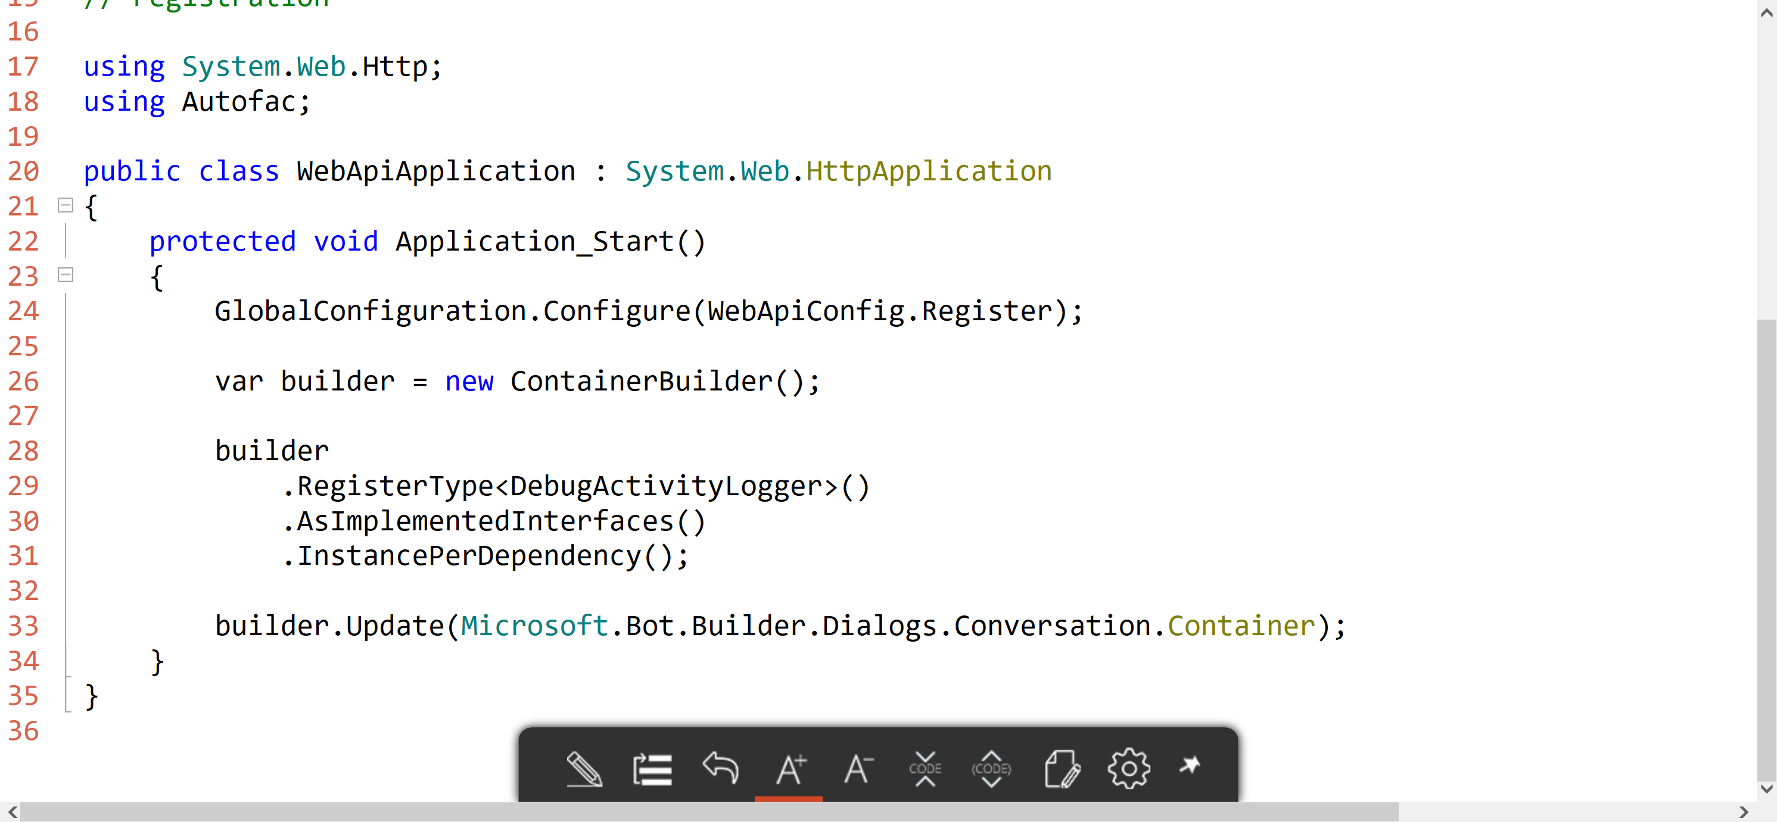
C# Middleware

Slide 6
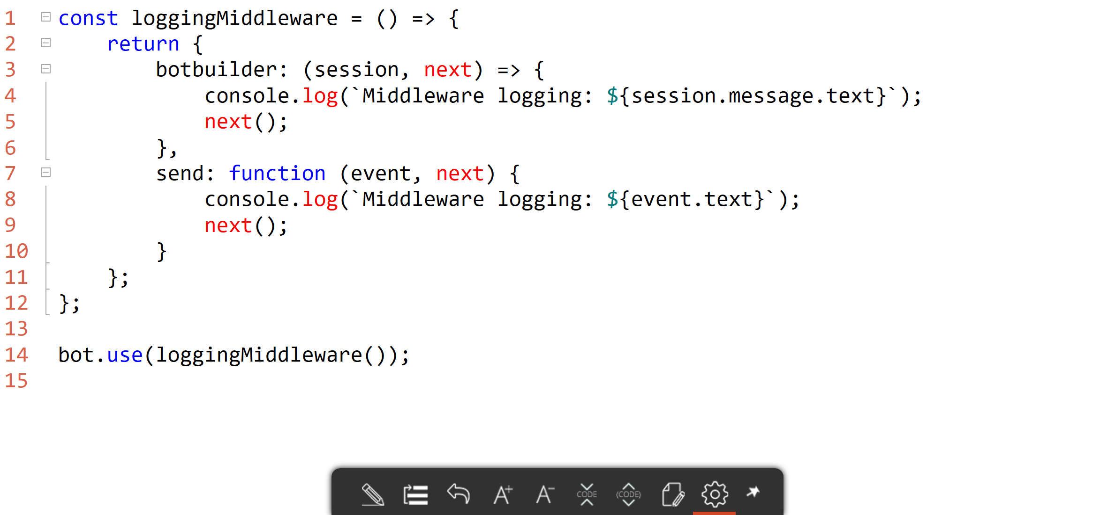
Node.js Middleware

Slide 7
Middleware

Slide 8
Handoff to Human
Every company deals with this:
First triage/data collection
Simple and repetitive solutions
Customer call
Complex cases and escalation

Slide 9
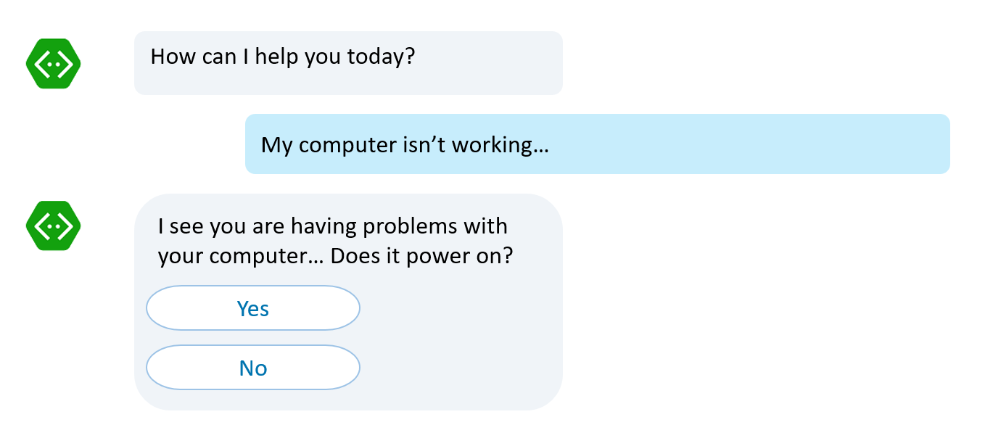
Handoff to Human
First triage/data collection
Simple and repetitive solutions
Customer call
No waiting in line to be helped Bots handle it
Complex cases and escalation

Slide 10
Handoff to Human
If it is simple and repetitive, it can be coded. Bots can accelerate it
First triage/data collection
Simple and repetitive solutions
Customer call
Complex cases and escalation

Slide 11
Handoff to Human
Bot to human hand off: Complete or supervised
Complex cases and escalation

Slide 12

Handoff to Human
Complete bot to human hand off
Thank you for providing all this information. I have John with me now who will take from here and help you out
Hello, this is John. I understand your computer won’t power on. Let’s take a look at some service options

Slide 13
Handoff to Human
Supervised bot to human hand off
I’ve tried these steps, my computer still won’t turn on
Note to operator: It sounds like the user will need hardware replacement, what next step should I take?
Apologize to user
Suggest hardware service
Let me type
I suggest us to request a hardware service. We can have one of our service engineers look at your computer
Sounds lovely, thank you

Slide 14
Handoff to Human
https://docs.microsoft.com/en-us/bot-framework/bot-design-pattern-handoff-human

Slide 15
Anatomy of a handoff

Slide 16
Customers
Agents

Slide 17
Customers
Agents

Slide 18
Customers
Agents

Slide 19
Customers
Agents

Slide 20
Customers
Agents

Slide 21
Agent Recognition
const isAgent = (session: BotBuilder.Session) => boolean;
Possible implementations
Username + Channel (“palindromed on Skype”);
Auth tokens via Direct Line backchannel
In this sample: username begins with “Agent”

Slide 22
Customers
Agents

Slide 23
Customers
Router
Agents

Slide 24
Customers
Router
Conversational
Metadata
Agents

Slide 25
Metadata
Conversation
Customer address
Agent address
Transcript
State
Bot
Waiting
Agent
Watch

Slide 26
State 1: Bot
switch (conversation.state) {
case ConversationState.Bot:
next();
}

Slide 27
Customers
Router
Conversational
Metadata
Agents

Slide 28
Customers
Router
Conversational
Metadata
Agents

Slide 29
Customers
Router
Conversational
Metadata
Agents

Slide 30
Customers
Router
Conversational
Metadata
Agents

Slide 31
Customers
Router
Conversational
Metadata
Agents

Slide 32
Customers
Router
Conversational
Metadata
Agents

Slide 33

How do we change state?

Slide 34
Handoff triggers
Customer bot logic
Intent/Command (“connect to agent”)
Text analytics (“This is getting really annoying”)
Default response has been sent too many times
Call center UX (button)
In this sample: Middleware to handle commands

Slide 35
State 2: Waiting
switch (conversation.state) {
case ConversationState.Waiting:
session.send(
"Connecting you to the next available agent.");
return;
}

Slide 36
Customers
“help”
Commands
Router
Conversational
Metadata
Agents

Slide 37
Customers
State: Waiting
Commands
Router
Conversational
Metadata
Agents

Slide 38
Customers
Commands
Router
Conversational
Metadata
Agents

Slide 39
State 3: Agent
switch (conversation.state) {
case ConversationState.Agent:
bot.send(
new builder.Message()
.address(conversation.agent)
.text(message.text));
return;
}

Slide 40
Customers
Commands
Router
Conversational
Metadata
Agents
“waiting”

Slide 41
Customers
State: Agent
Commands
Router
Conversational
Metadata
Agents

Slide 42
Customers
Commands
Router
Conversational
Metadata
Agents

Slide 43
Customers
Commands
Router
Conversational
Metadata
Agents

Slide 44
Customers
Commands
Router
Conversational
Metadata
Agents

Slide 45
Customers
Commands
Router
Conversational
Metadata
Agents

Slide 46
Customers
Commands
Router
Conversational
Metadata
Agents

Slide 47
Customers
Commands
Router
Conversational
Metadata
Agents

Slide 48
Customers
Commands
Router
Conversational
Metadata
Agents

Slide 49
Customers
Commands
Router
Conversational
Metadata
Agents

Slide 50
State 4: Watch
switch (conversation.state) {
case ConversationState.Watch:
bot.send(
new builder.Message()
.address(conversation.agent)
.text(message.text));
next();

Slide 51
Customers
Commands
Router
Conversational
Metadata
Agents
“watch customer”

Slide 52
State: Watch
Customers
Commands
Router
Conversational
Metadata
Agents

Slide 53
Customers
Commands
Router
Conversational
Metadata
Agents

Slide 54
Customers
Commands
Router
Conversational
Metadata
Agents

Slide 55
Customers
Commands
Router
Conversational
Metadata
Agents

Slide 56
Customers
Commands
Router
Conversational
Metadata
Agents

Slide 57
Handoff in action

Slide 58
Your turn
Update your bot to:
Allow users to communicate with help desk personnel

